Slide 1

Twin Rotor
Zigler Alexandru

Slide 2
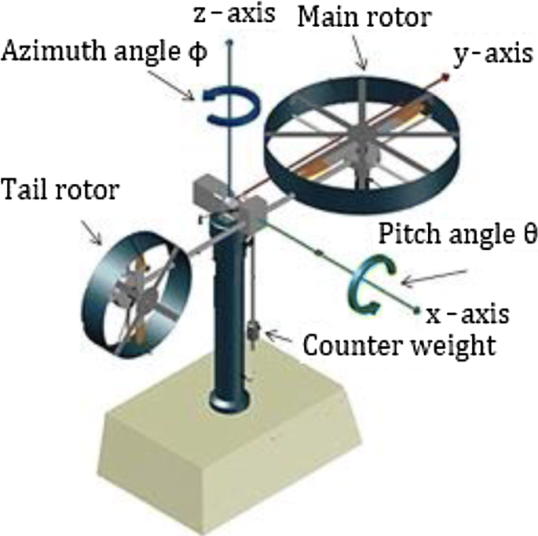
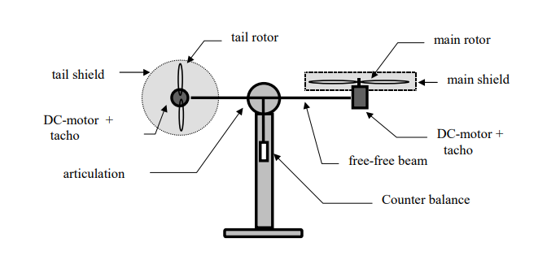
System definition

Slide 3
Objectives
Study and understand system definition and architecture, familiarize with operating software
Perform data acquisition in different scenarios (e.g. open loop with signals like step, PWM, sine wave, closed loop with predefined PID controllers)
Identify the mathematical model of the plant
Design PID controllers in order to stabilize the system around an operating point
Test the controllers on the lab stand

Slide 4
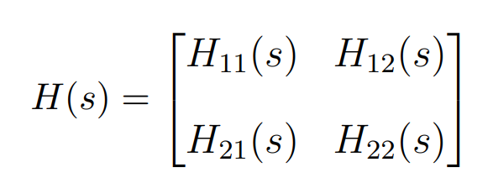
Linearized transfer function matrix
H11(s) – transfer function from input 1 (tail rotor) to output 1 (azimuth)
H12(s) – transfer function from input 2 (main rotor) to output 1 (azimuth)
H21(s) – transfer function from input 1 (tail rotor) to output 2 (pitch)
H22(s) – transfer function from input 2 (main rotor) to output 2 (pitch)

Slide 5
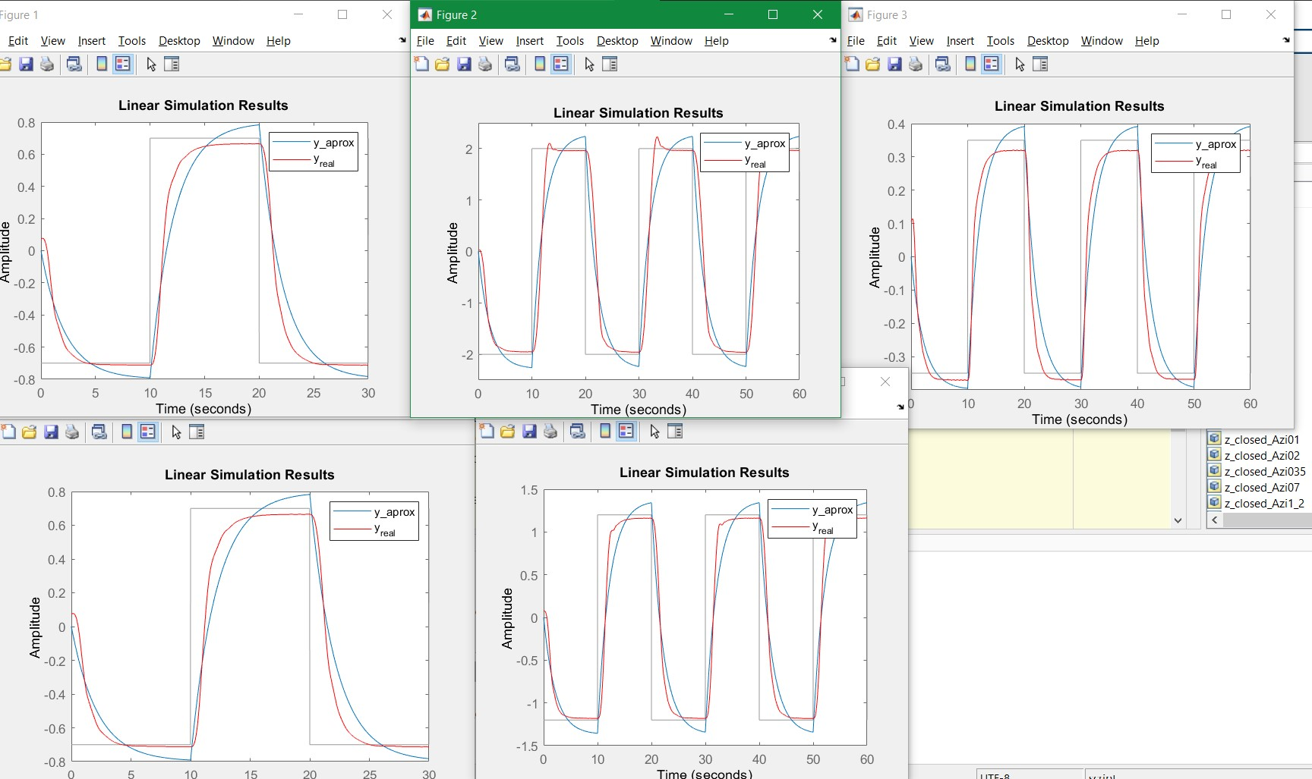
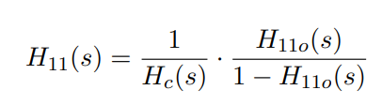
Identification H11(s) – closed loop
This transfer function is unstable.
Open loop identification did not have satisfactory results.
We perform data aquisiztion in closed loop, with a PID. We identify the output, then reverse engineer the model of the system.

Slide 6
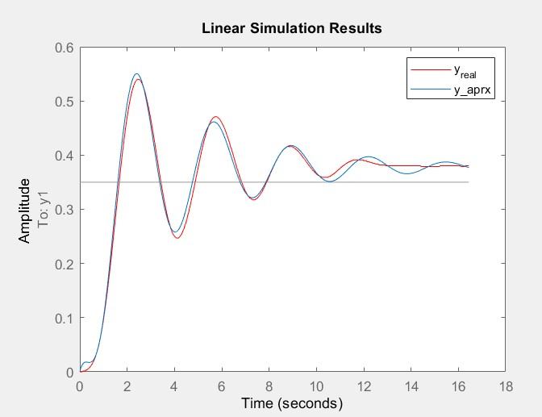
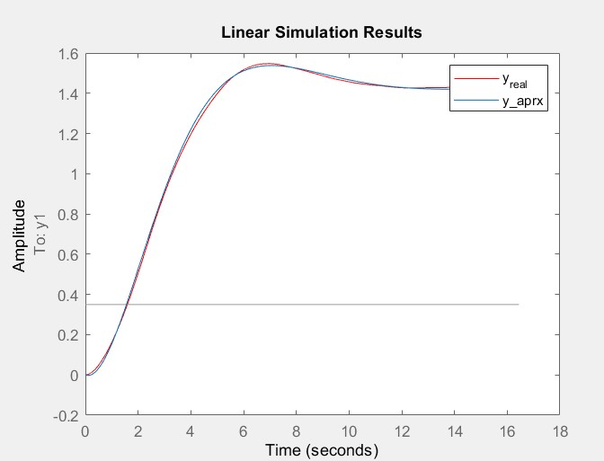
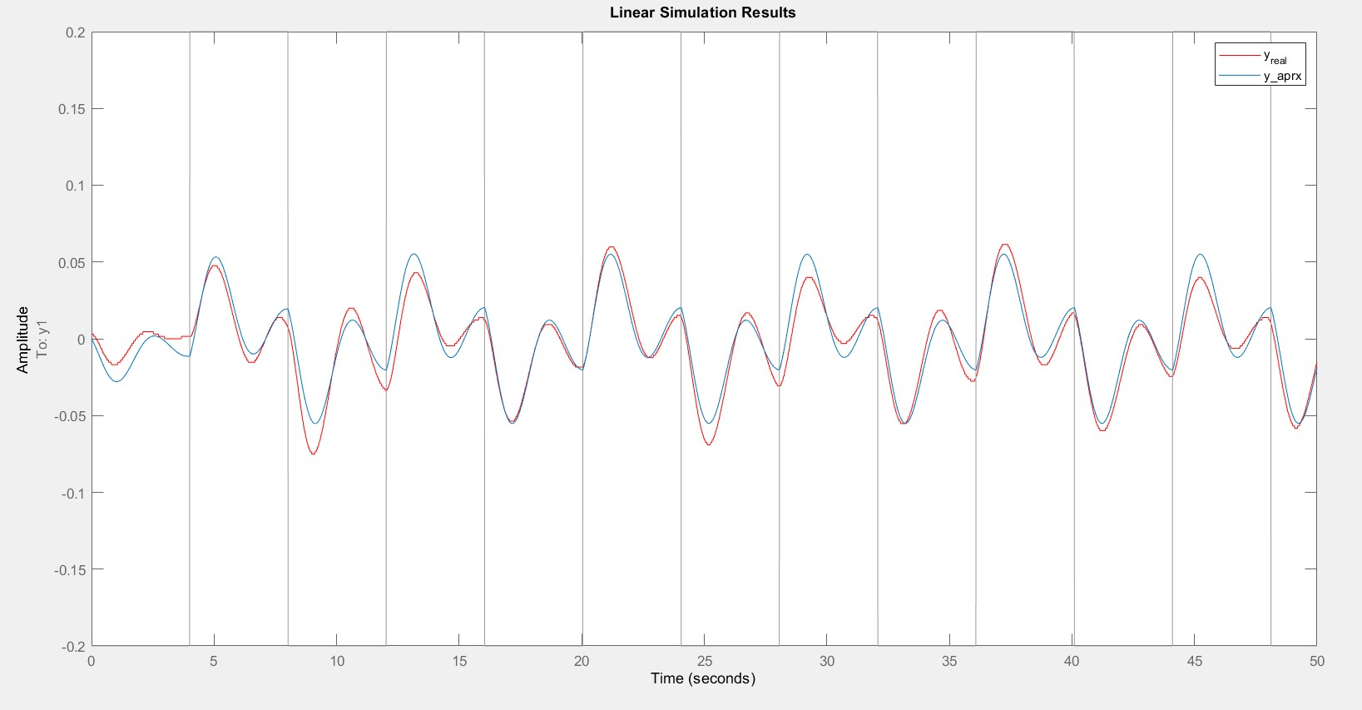
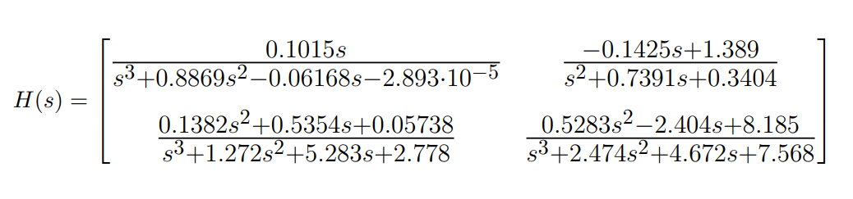
Identification H12(s), H21(s), H22(s)
We used tfest function for multiple datasets and for different transfer function orders

Slide 7
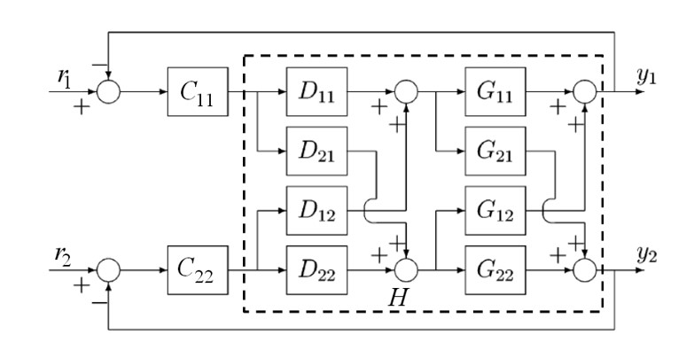
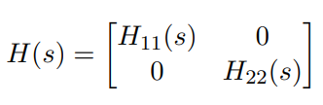
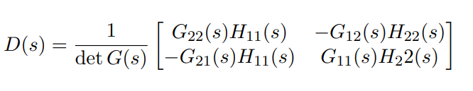
Decoupling method
G(s) – previously identified system
H(s) – imposed system that we want to obtain
D(s) – decopling matrix

Slide 8
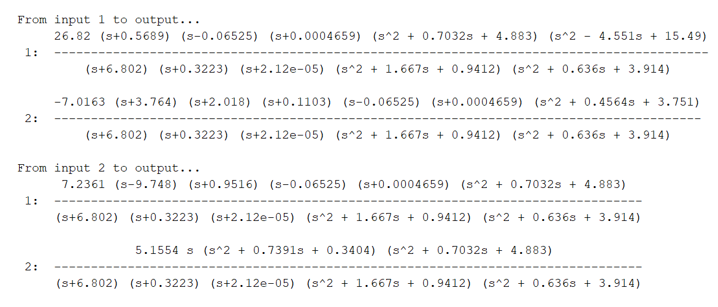


Decoupling method
Matrix D:
We select H11(s) și H22(s) – causal such that matrix D is implementable and stable

Slide 9
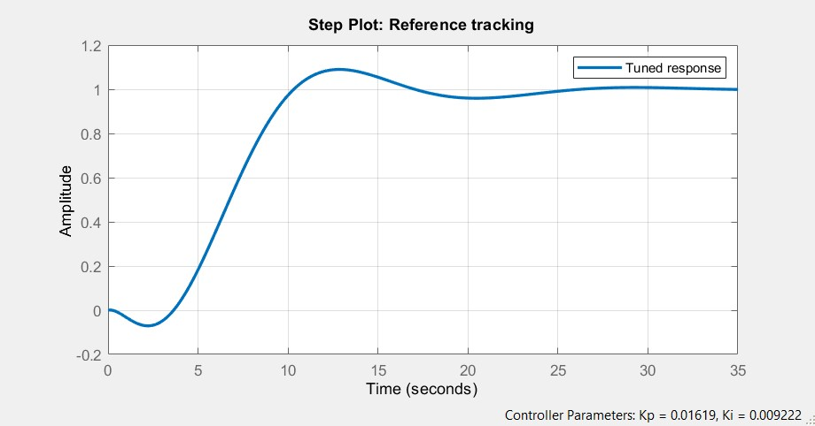
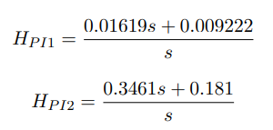
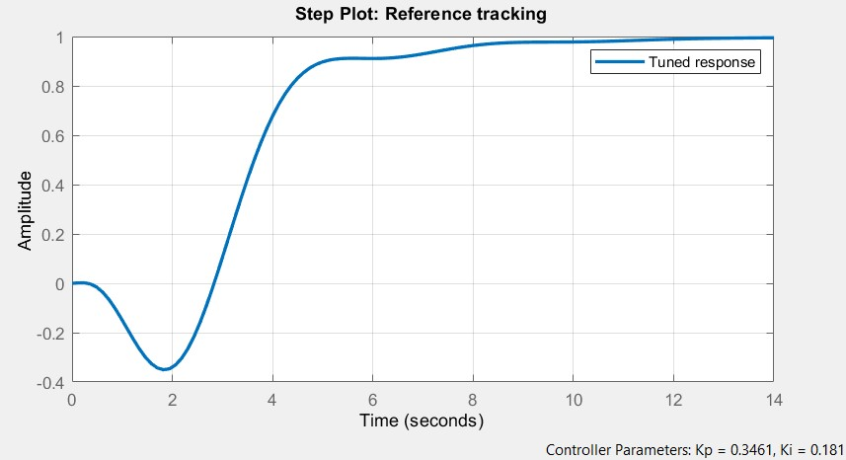
PI Controllers

Slide 10
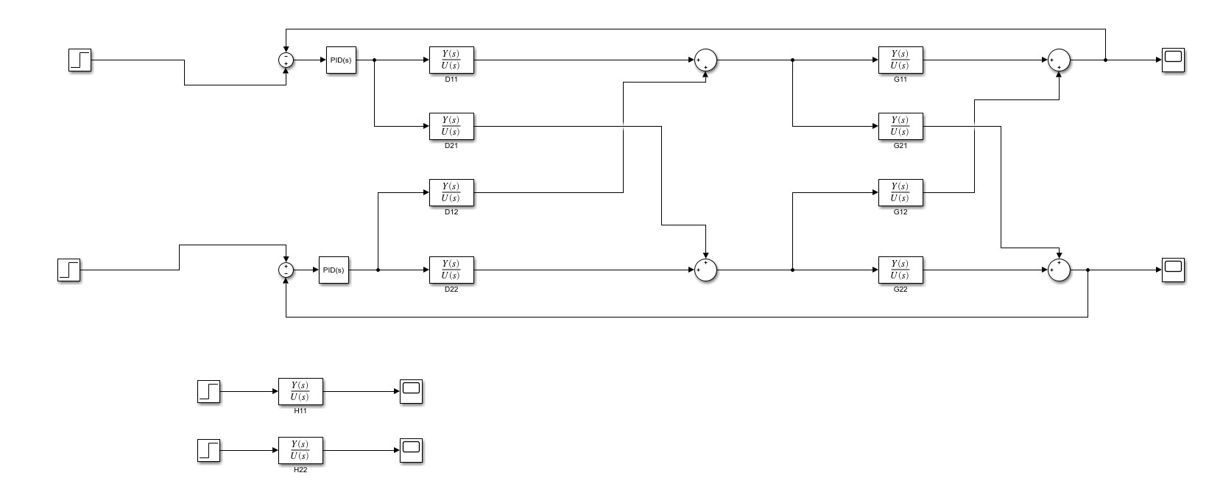
Decoupling implementation - Simulink

Slide 11
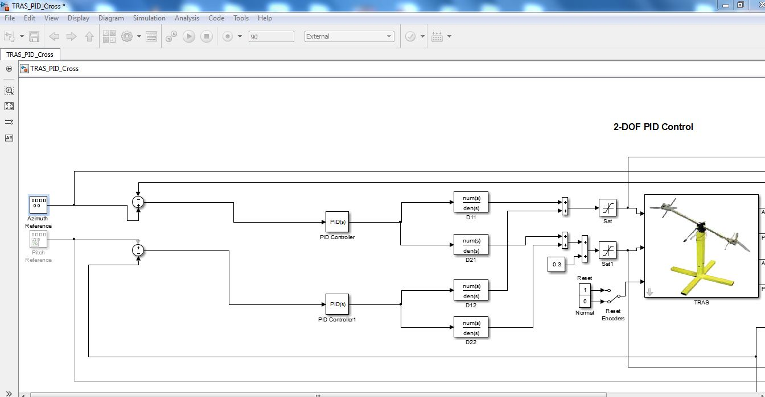
Implementation of control system

